Slide 1


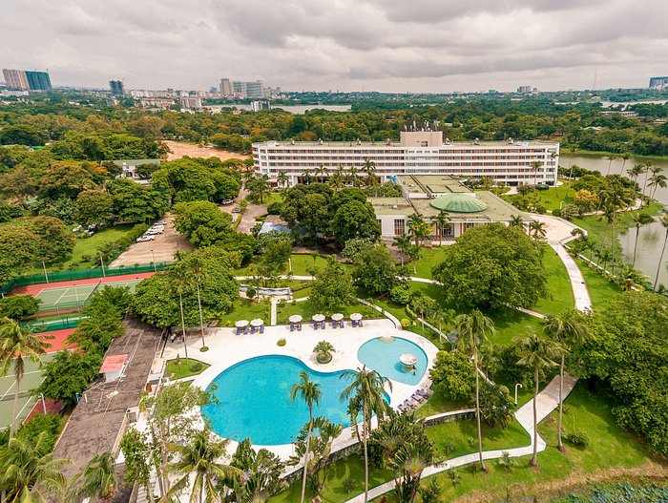
Network Operators’ Forum 2026
Hosted by Myanmar Internet Exchange (MMIX) and Myanmar Network Operators’ Group (MMNOG), this forum unites Internet industry leaders, network engineers, operators, content providers, government representatives, and international organizations to foster peering, share technical expertise, and strengthen Myanmar’s Internet ecosystem.
Why Attend
Date
• Build peering relationships
• Exchange technical and operational expertise
• Connect with regional and global Internet stakeholders
• Support resilient Internet infrastructure development
We warmly invite Network Operators, Engineers, and Industry Professionals to participate and contribute to the advancement of MMIX & MMNOG. More information: mmnog.net.mm/MMNOG8-YGN/

Slide 3
What are “Peering Personals”?
Chance for everyone to introduce their networks :)
The community gets a chance to build a better connected Internet …
“One Peering session at a time!”

Slide 4
Peering Personals Template guide :)
1. ISP/CDN; WHO to Peer
Basic information of Network Operators to establish peering ( ASN, Policy, location, etc)
2. Data Center(DC); WHERE (location) to peer
DC information(name, location, etc) that hosts Peers, IXPs and transport providers

Slide 5
ISP/CDN
<Company>
<Company logo>
ASN | <XXX>
Traffic Profile | Content / Eyeballs / Balanced
Traffic Volume | <xbps>
Peering Policy | Open / Selective / Restictive
Peering Locations | (IXP/ DC/Location) Indicate especially Asia and Oceana
Peeringdb Entry | asxxx.peeringdb.com
Contact Information | <name>, email <peering@domain.com>
photo
Name
Updates: <indicate, if any>

Slide 6
Data Center
<Company>
<Company logo>
Data Center | <name1> | <name2>
Location | <City, Country> | <City, Country>
IXP Presence | <IXPs> | <IXPs>
Colocators: ASN presence | <Colocator count> | <Colocator count>
Subsea cables presence/access | <Landed / Extended> | <Landed / Extended>
DC specification (Rack, Floor space, Power) | <rack count /util, Floor space max power> | <rack count /util, Floor space max power>
DC URL reference | DC website | DC website
DC to DC Interconnection | <DCs with interconnection & type> | <DCs with interconnection & type>
Peeringdb | <https://www.peeringdb.com/fac/xxx> | <https://www.peeringdb.com/fac/xxx>
photo
Contact Person/s
Contact information
Updates: <indicate, if any>

Slide 7


MMIX MMNOG
Forum 2026

